Slide 1
Modifying Data
C393: Database Systems

Slide 2
Review

Slide 3
Lesson Objectives
Modify data using INSERT, UPDATE, and DELETE statements

Slide 4
INSERT INTO
INSERT INTO TableName
VALUES (value, value, ...)
[, (value, value, ...) ];
INSERT INTO TableName (columnName, columnName, ...)
VALUES (value, value, ...)
[, (value, value, ...) ];

Slide 5
INSERT INTO Examples
INSERT INTO Cadet VALUES
('123', 'John', 'Smith', 'A'),
('234', 'Mike', 'Jones', 'B’);
INSERT INTO CadetAccount (owner, balance) VALUES
('123', 100),
('123', 200),
('456', 500),
('678', 900);
No columns specified…
Columns specified, notice that accountId is AUTO_INCREMENT
If you do not specify a column, it will assume NULL or DEFAULT value.
If a column is NOT NULL and there is no default, you must specify it.

Slide 6
UPDATE
UPDATE TableName
SET columnName = value[, columnName = value, ...]
[WHERE condition];

Slide 7
DELETE
DELETE FROM TableName
[WHERE condition];

Slide 8
Examples
UPDATE CadetAccount
SET balance = 100000000000;
UPDATE CadetAccount
SET balance = -10000
WHERE owner = ‘123’;
DELETE CadetAccount;
DELETE CadetAccount
WHERE owner = ‘123’;

Slide 9
Examples
UPDATE CadetAccount
SET balance = (
SELECT MAX(balance)
FROM CadetAccount
)
WHERE owner IN (
SELECT DISTINCT owner
FROM CadetAccount
ORDER BY balance ASC
LIMIT 5
);

Slide 10
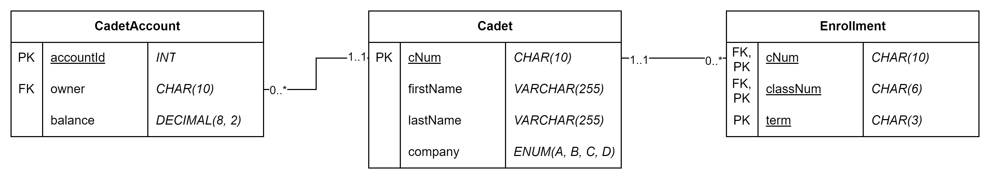
Try it out
Download/import the cadet database
Solve all the cadet_modification.mysqlnotebook queries

Slide 11
A word of warning…
None of these queries have a “confirmation” button.
Once you send the transaction, they start processing.
Always run the query first as a SELECT * FROM…
UPDATEs and DELETEs may have consequences with FOREIGN KEY
ON UPDATE, ON DELETE – RESTRICT, CASCADE, SET NULL

Slide 12
FOREIGN KEY
ON DELETE, ON UPDATE
RESTRICT – default, the operation is not allowed if there is at least one linked record
SET NULL – sets the corresponding foreign key to null
CASCADE – deletes the corresponding record
Review the cadet_keys.sql file
Run the cadet_keys.sql file
Finish the rest of the cadet_modify notebook.

